Slide 1
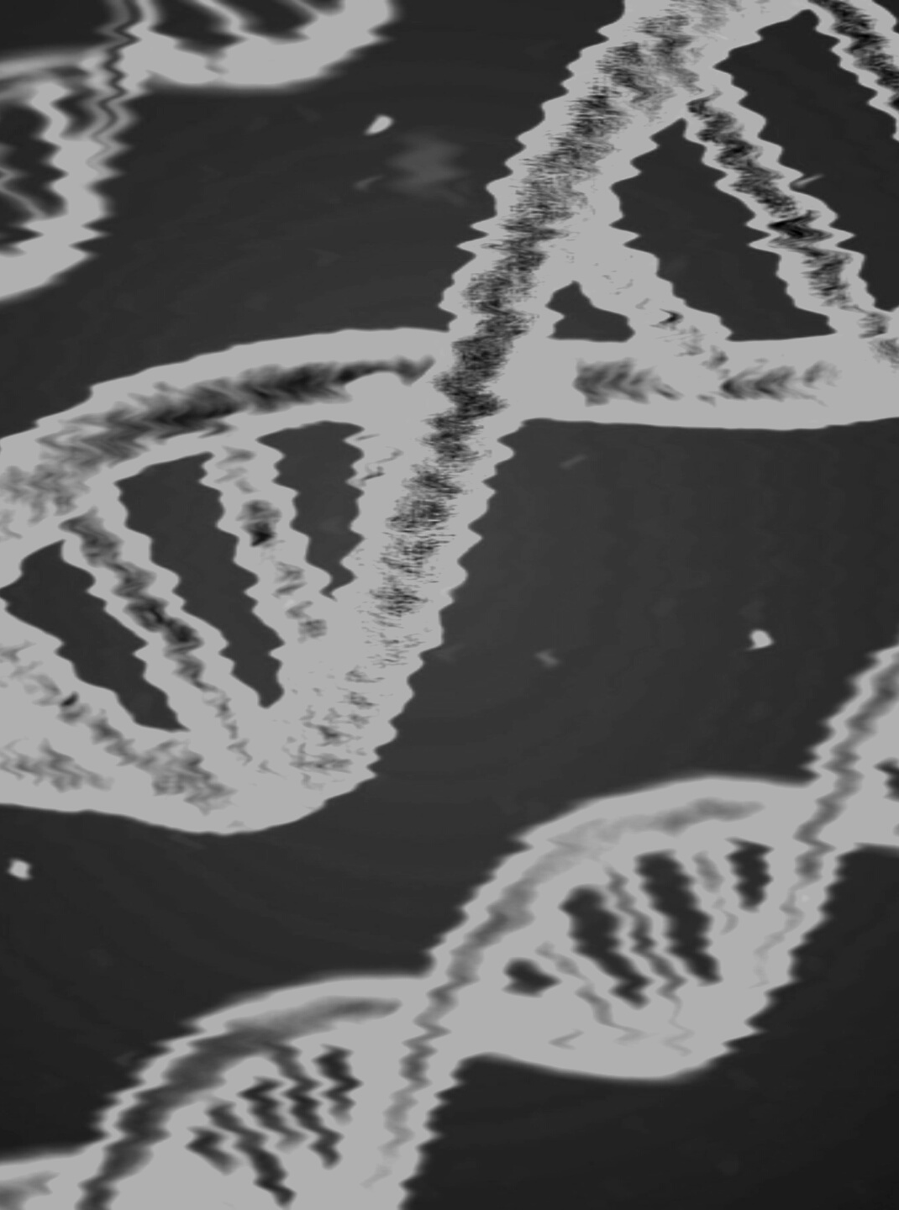
UNIVERSITY OF NOTRE DAME
Identifying Cancer with Machine Learning
Case Study by Aldo, Avisek, & Kait

Slide 2

LIST OF KEY CONCEPTS
- Using machine learning techniques to assist in identifying malignant tumors
- Findings using decision trees
- Findings using random forests/bagging
- Findings using Kth Nearest Neighbors
- Conclusion
Our Agenda for Today

Slide 3
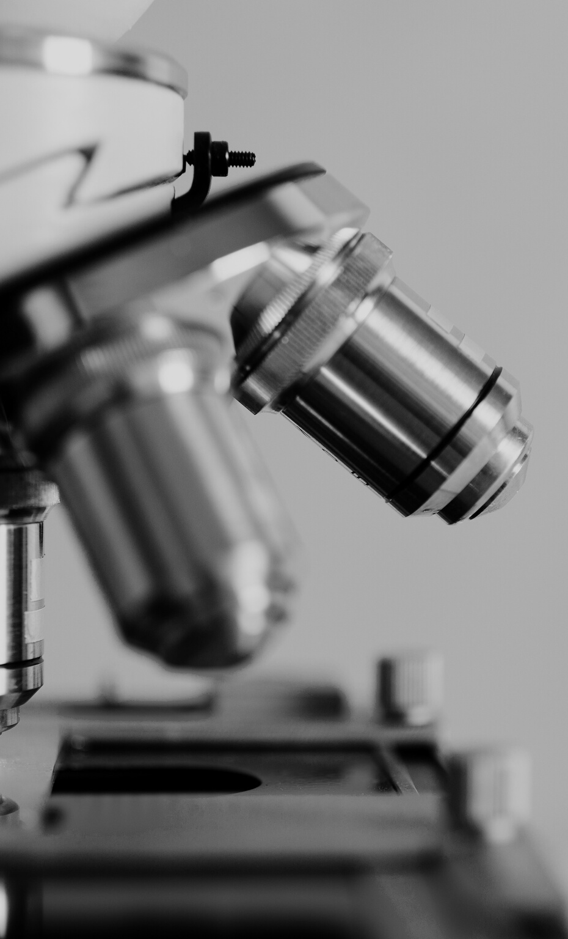
What is
machine learning?
COMPUTER GUIDED DECISION MAKING
Machine Learning is a set of methods which enables the computer to take decisions or infer conclusions without us guiding it.

Slide 4
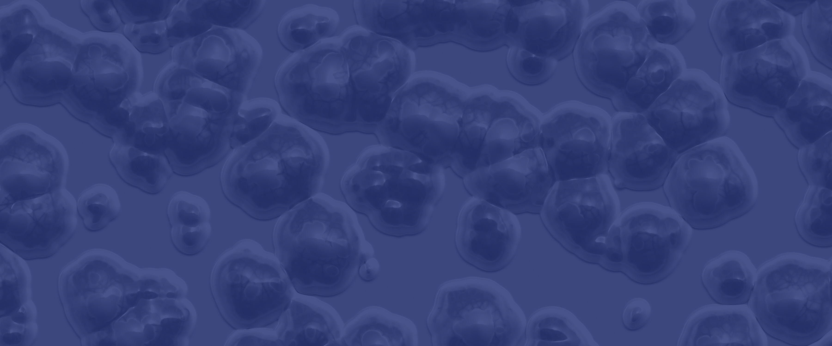
"...AI [and machine learning] will not replace doctors, but instead will augment them, enabling physicians to practice better medicine with greater accuracy and increase efficiency. "
Benjamin Bell

Slide 5

Just like a human, a computer can learn from 3 sources.
How a computer learns:
One | Supervised
Observing what others did in similar situations
Two | Unsupervised
Observing a situation and trying to come up with best possible logic on the spot to decide/conclude
Three | Reinforcement
Learning from previous mistakes/success.

Slide 6

OUR FOCUS
Supervised Learning Techniques:
Decision Trees
Random Forests/Bagging
Kth Nearest Neighbors

Slide 7
Overview of Classification Techniques
Decision Trees
Kth Nearest Neighbor
Random Forest/Bagging
Simply a set of cascading questions. You use each attribute (i.e. a value of a given feature of the data point) to answer a question. The answer to each question decides the next question. At the end of this sequence of questions, you will end up with a probability of the data point belonging to each class, or in this case, diagnosis.
A form of pattern recognition, in which we associate what we are trying to predict with another value that is the closest/most similar to it, calculating the distance between points on a graph. The KNN algorithm assumes that similar things exist in close proximity.
A model made up of many decision trees and each tree learns from a random sample of the data points The concept of bagging implies that some samples will be used multiple times in a single tree. The predictions are made by averaging the predictions of each decision tree.

Slide 8
Application of Algorithms in Diagnosis Prediction
Random Forest/Bagging
Decision Trees
Kth Nearest Neighbor
• Determining the species of an animal
• Determining the species of an animal with multiple decision trees
• Behavioral segmentation by purchase history
ie. Consumer A's purchase behavior resembled consumer B, so we will assume they will purchase similar to Consumer B in the future
ie. Species 1 can be determined by a series of atributes and Species 2 has a different series of attributes. S
ie. Take the example used for Decision Trees & picture 500 trees each created by randomly sampling our data

Slide 9
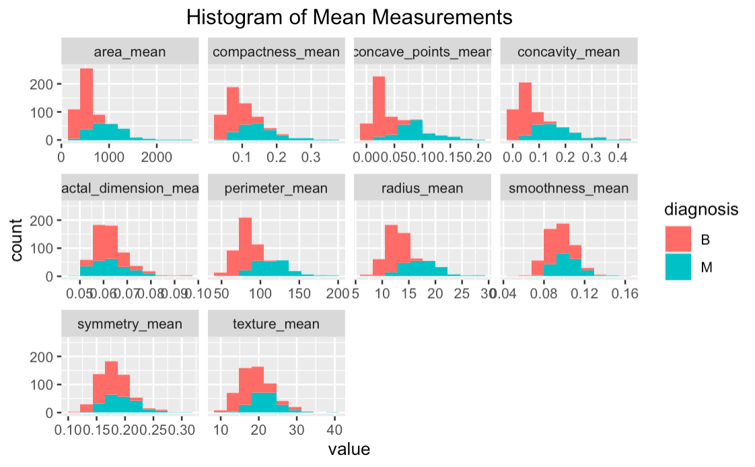
Mean Measurements
OUR FINDINGS:
In some of the mean histograms, we see vast differences between the distributions for benign and malignant tumors (orange and blue). While for others, the distributions are relatively similar.
For example, the area_mean chart has vastly different distributions for the orange and blue data, which means that the mean values for benign and malignant area_means

Slide 10
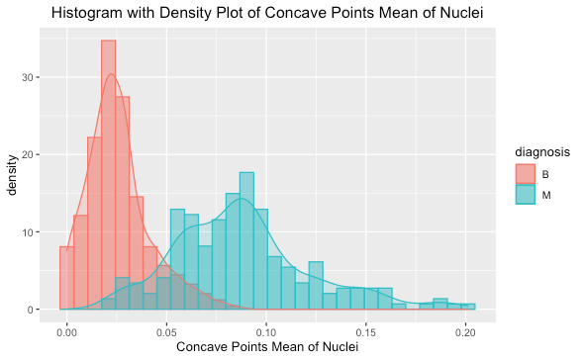
1
EDA Output
WHAT DID WE FIND?
Ellaborate....

Slide 11
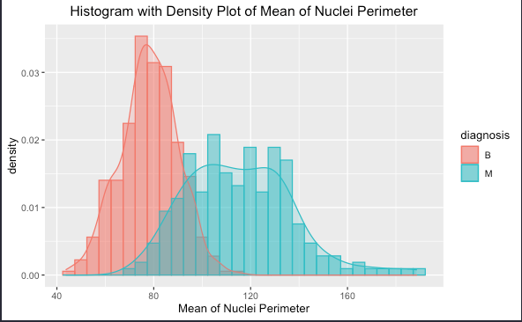
2
EDA Output
WHAT DID WE FIND?
Ellaborate....

Slide 12
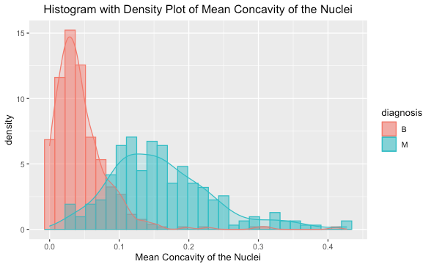
3
EDA Output
WHAT DID WE FIND?
Ellaborate....

Slide 13
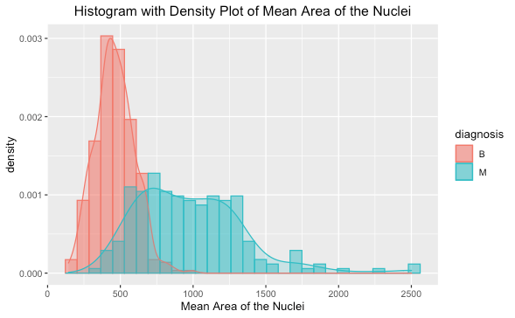
4
EDA Output
WHAT DID WE FIND?
Ellaborate....

Slide 14
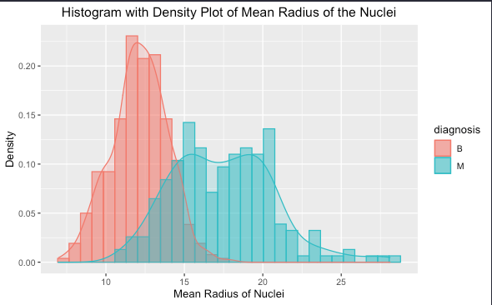
5
EDA Output
WHAT DID WE FIND?
Ellaborate....

Slide 15
The most powerful predictors...
CONCAVE POINTS MEAN
PERIMETER MEAN
CONVAVITY MEAN
AREA MEAN
RADIUS MEAN
*This has been calculated using the importance() function in R.

Slide 16
Talking point
EXPAND UPON IMPORTANCE() FUNCTION AND HOW WE ARE USING THIS FOR BAGGED TREE AND ALSO AS A GUIDING PRINCIPLE FOR WHAT TO FOCUS ON FOR OUR INTRODUCTORY SECTION
*This has been calculated using the importance() function in R.

Slide 17
Takeaways from statistical significance of predictors
Our interpretation of how this should be utilized by doctors
When viewing reports, ____ should be a primary focus as we found it to be the most statistically significant predictor.
ABC
123
321

Slide 18
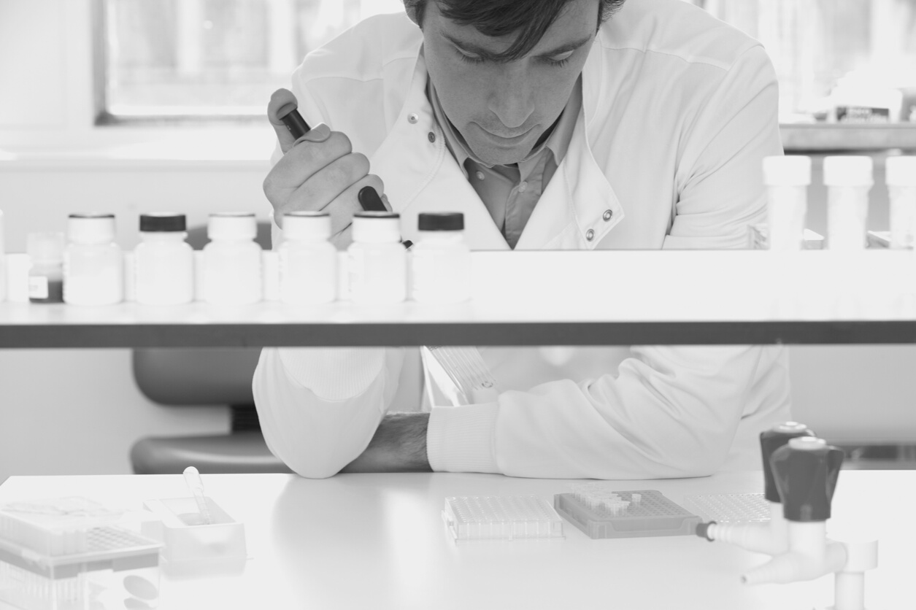
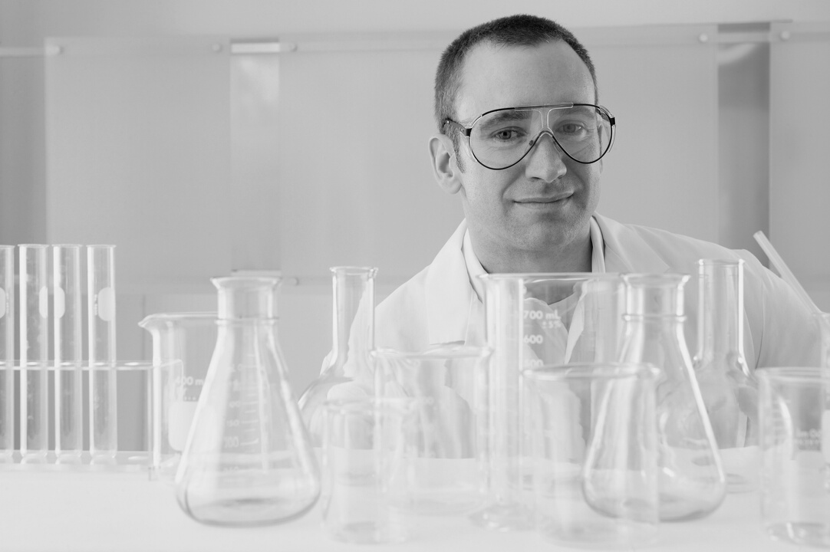
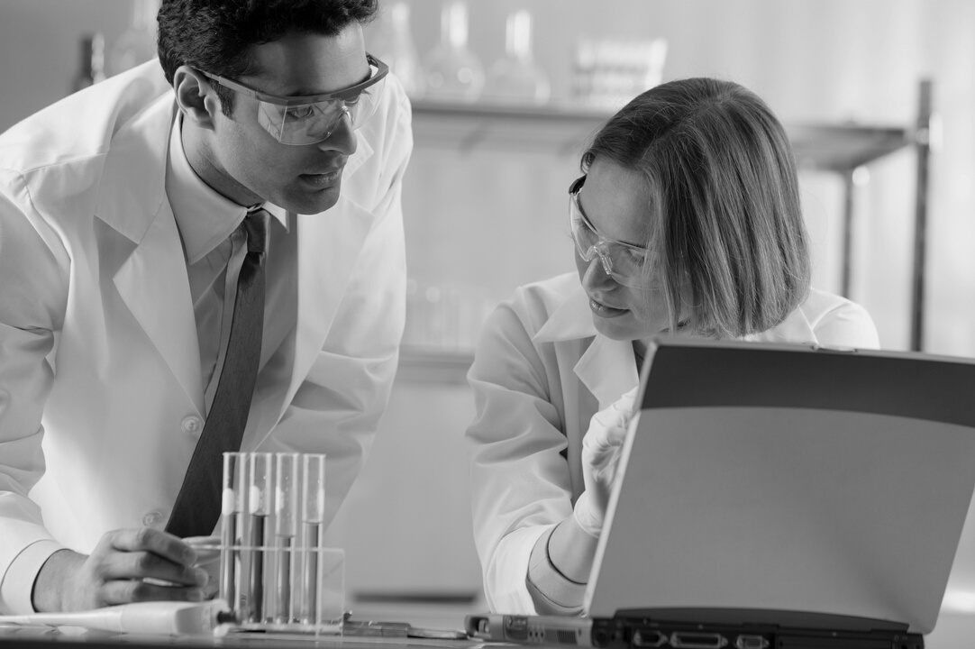
1. Finding 1
Ellaborate
2. Finding 2
Ellaborate
3. Get results in
30 minutes.
Main Findings
Ellaborate

Slide 19
ADDITIONAL DETAILS ABOUT MODEL OUTPUTS
XYZ
ABC
123
321

Slide 20

MORAL CONSERVATISM
Further Learnings/Takeaways
Presentations are communication tools that can be used as demonstrations.
HUMAN RIGHTS INTERFERENCE
Presentations are communication tools that can be used as demonstrations.
RISKS AND REWARDS
Presentations are communication tools that can be used as demonstrations.
SOCIAL JUSTICE
Presentations are communication tools that can be used as demonstrations.

Slide 21
Benefits & Risks of Machine Learning
False Negatives vs False Positives
Fill this in with more info.....

Slide 22


Sources of our Research
https://medium.com/@kuthayasankar/what-is-machine-learning-explain-like-i-am-5-year-old-a8f25aed703d
https://towardsdatascience.com/machine-learning-101-for-dummies-like-me-bdc6d03e1a38
https://amzn.to/2O2WWnj
https://towardsdatascience.com/understanding-random-forest-58381e0602d2

Slide 23



The team @
Notre Dame
Aldo Adriazola
Principal Member of Technical Staff @ AT&T
Avisek Choudhury
Business & Application Tech Specialist @ North Carolina State University
OUR IN-HOUSE
DATA EXPERTS
Kait Arnold
Analytics Engineer @ VSP Global

Slide 24
Contact Us
HOW TO REACH US
Mailing Address
123 Anywhere St., Any City, State, Country
Phone Number
(123) 456 7890
E-mail Address
hello@reallygreatsite.com

Slide 25

“Machine Learning is the science of getting computers to learn and act like humans do, and improve their learning over time in autonomous fashion, by feeding them data and information in the form of observations and real-world interactions.”

Slide 26
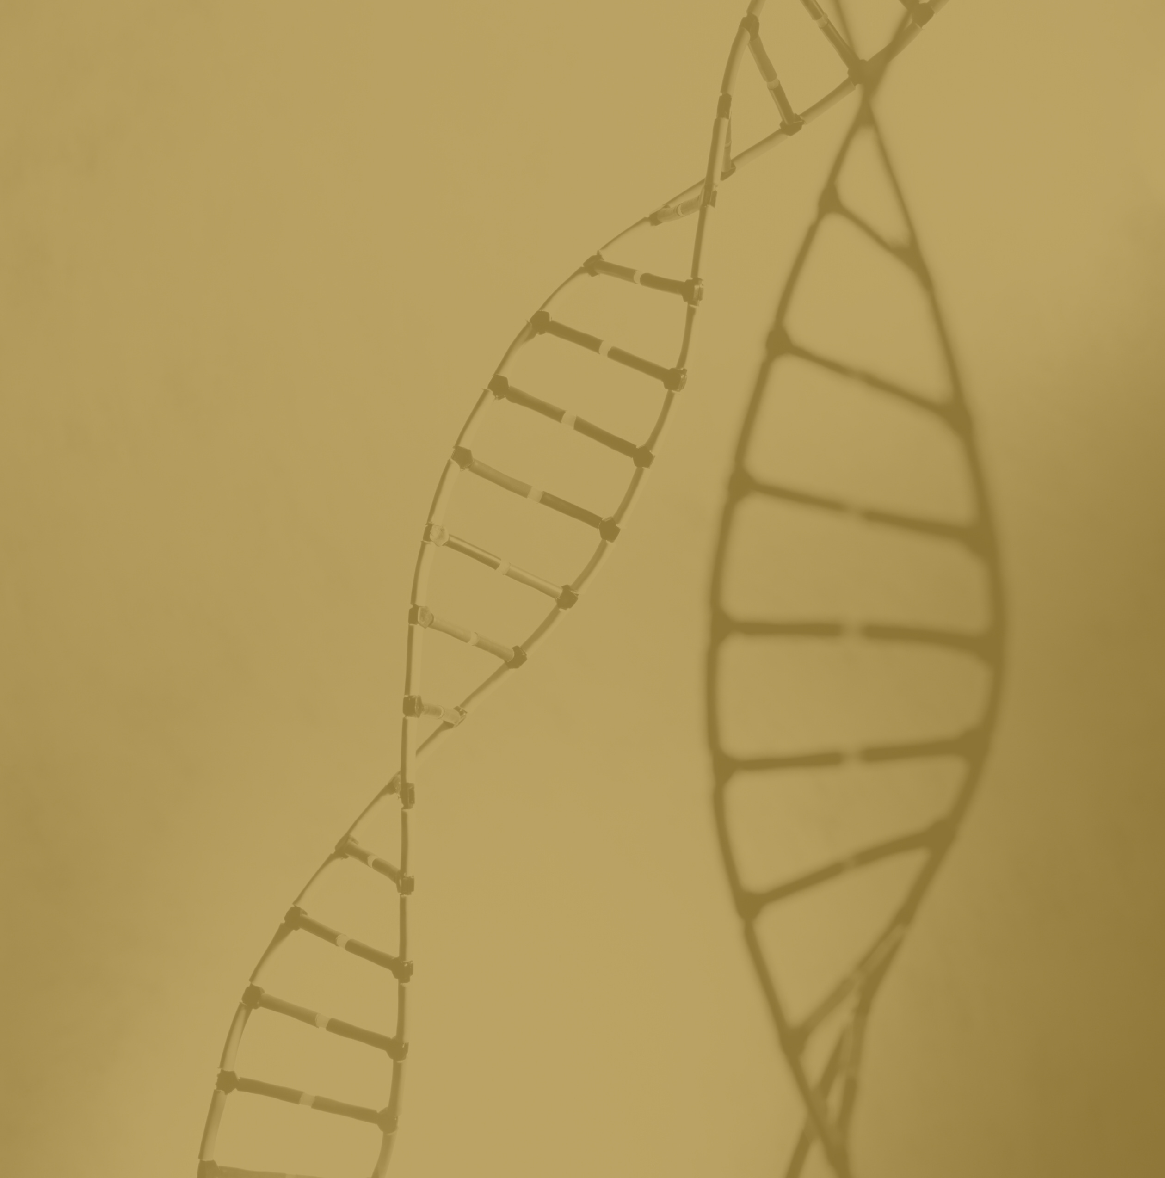

Crash Course on CRISPR
Presentations are communication tools that can be used as demonstrations, lectures, speeches, reports, and more.

Slide 27

Livestock Modification
FARM ANIMALS WITH NEW FEATURES
Castration-free pigs
Fatter lambs
Horn-free calves
Flu-resistant chickens

Slide 28

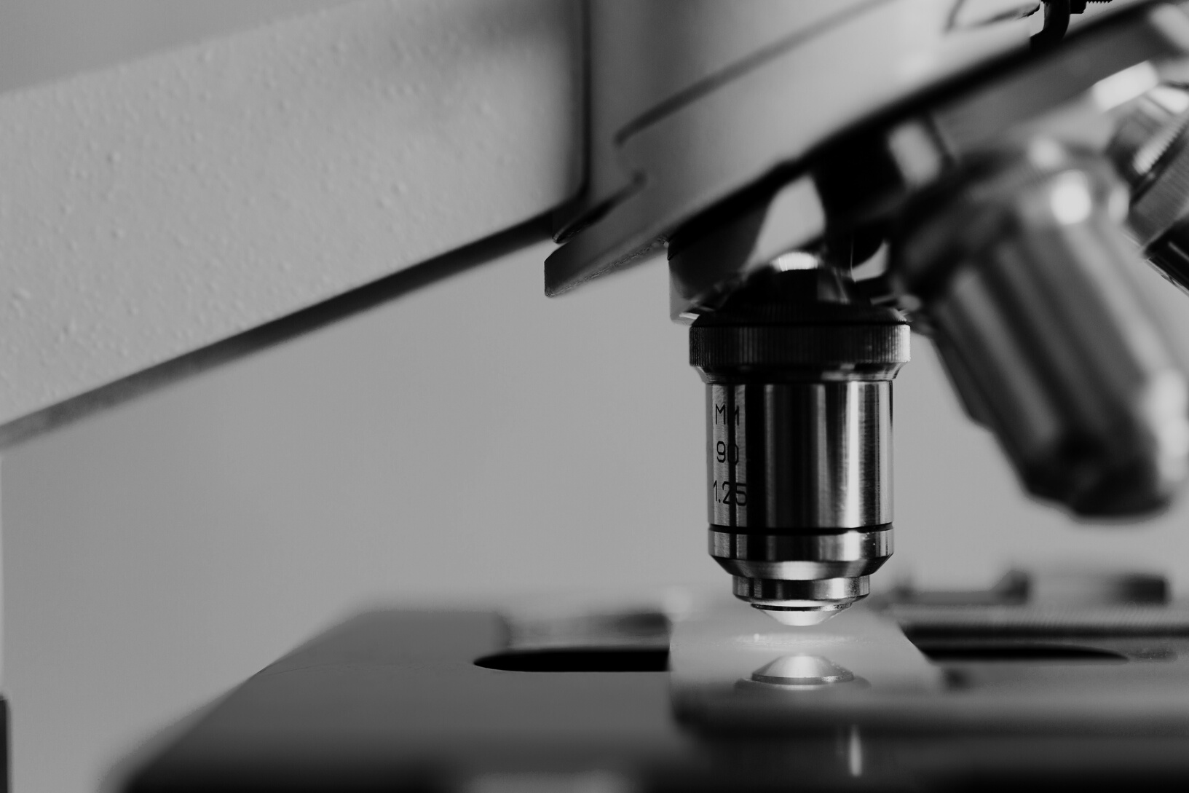
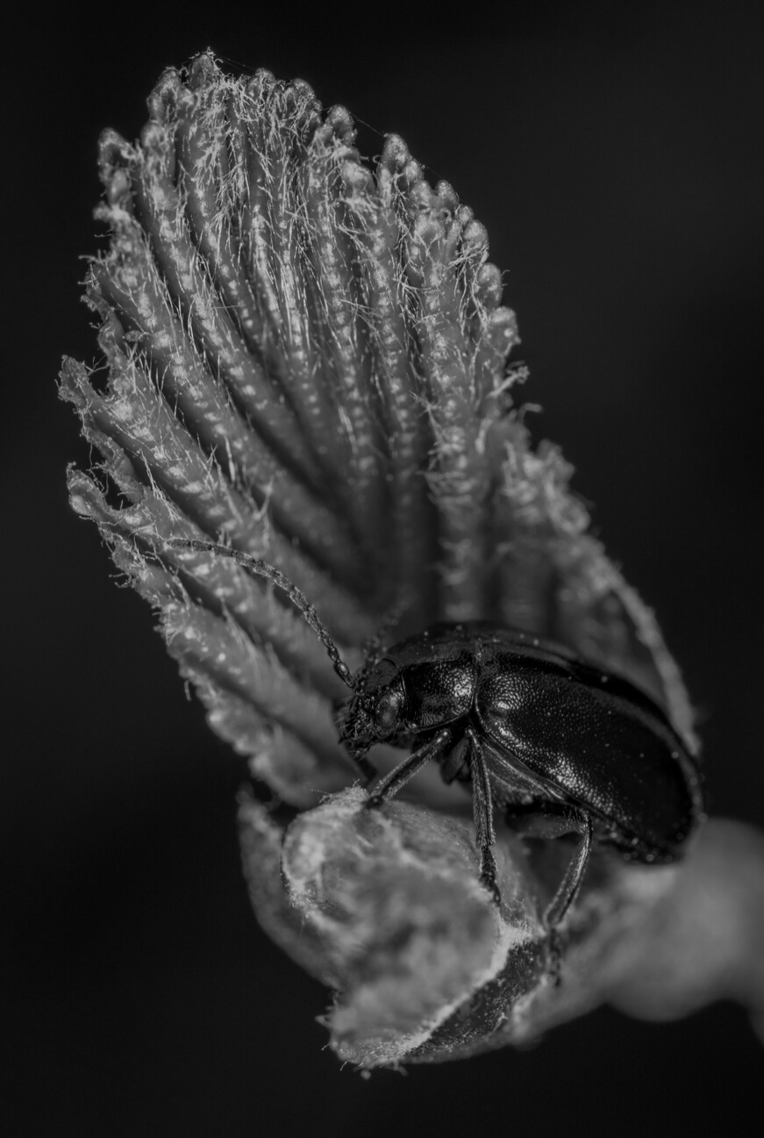
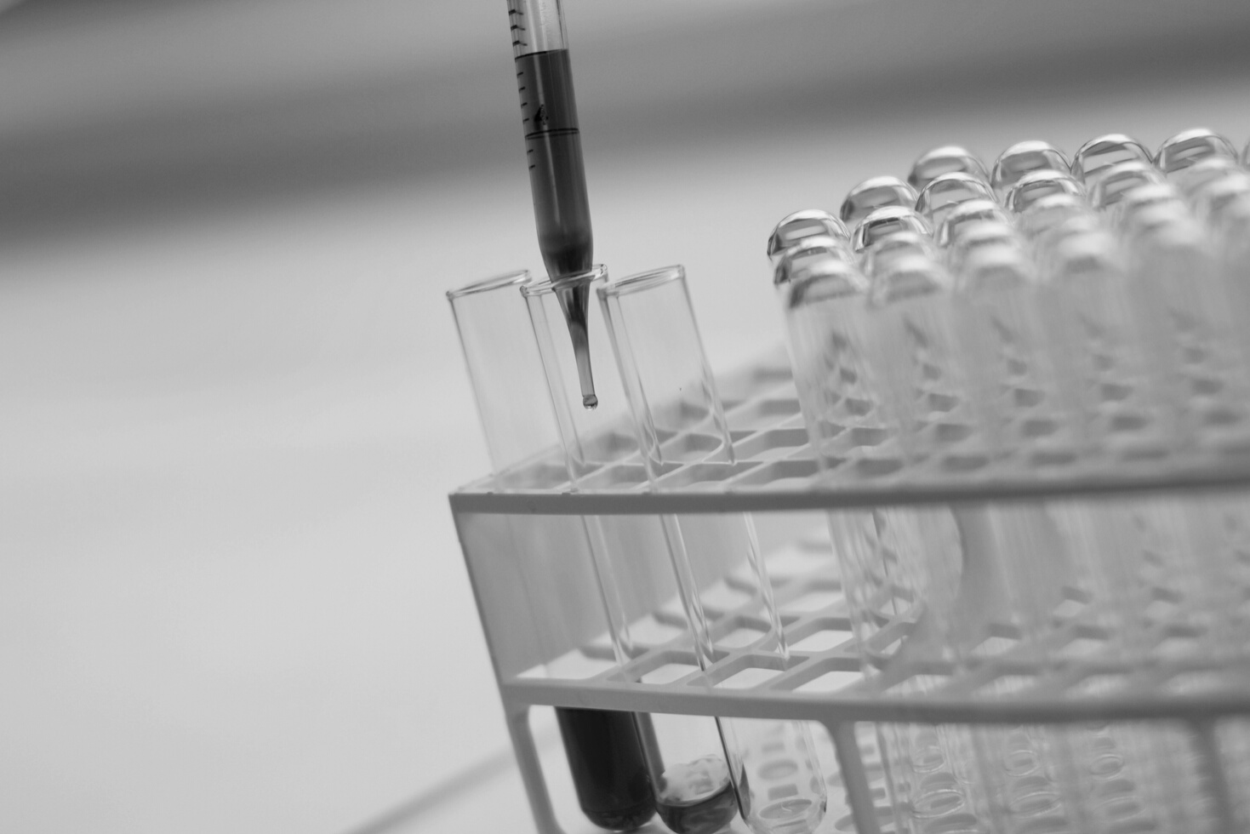
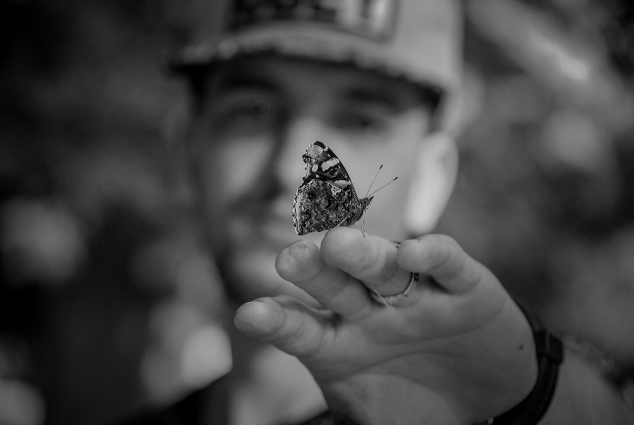
GENE EDITING ON HUMANS
GENE EDITING ON HUMANS
Presentations are communication tools that can be used as demonstrations.

Slide 29
Public Opinion on Morality
Item 5
20%
Item 1
20%
Item 5
20%
Item 1
20%
Item 5
20%
Item 1
20%
Item 4
20%
Item 2
20%
Item 4
20%
Item 2
20%
Item 4
20%
Item 2
20%
Item 3
20%
Item 3
20%
Item 3
20%
Very Religious
Somewhat Religious
Not Religious

Slide 30
Timeline of Gene Editing
KEY SCIENTIFIC BREAKTHROUGHS
1971: Gene-splicing experiment is conducted.
1982: Synthetic insulin is invented.
1996: Genetically modified crops appear.
2012: CRISPR is discovered for gene editing.
Presentations are communication tools.
Presentations are communication tools.
Presentations are communication tools.
Presentations are communication tools.

Slide 31

Gene Editing on
Plants & Animals
IMPACT ON FOOD SUPPLY
Presentations are communication tools that can be used as demonstrations, lectures, speeches, reports, and more.

Slide 32
18,000
17,500
New jobs in gene and cell therapy in the UK by 2030
New jobs in gene and cell therapy in the US by 2030

